Slide 1
Exploratory Data Analysis (EDA) with Pandas
Nestor Teodoro Chavez
Marti Heit
Joleena Marshall
Faye Pei

Slide 2



EDA: Why It’s Important
Handle outliers and missing data in the early stages
Using unprocessed data in modeling or making inferences can lead to misleading and unreliable results
Helps us decide the best model to use to answer our research questions
Notes:
Joleena

Slide 3
EDA Overview
Import Data
Exploration
Preprocessing
Visualization
Goal: Get acquainted with and gain insights from data
Tools: Pandas and Matplotlib (Visualization)
Notes:
joleena

Slide 4
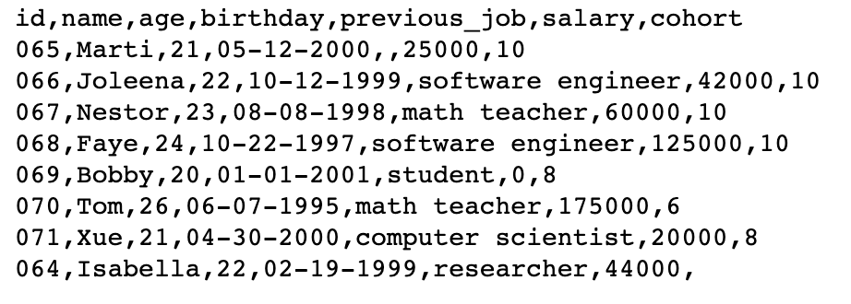
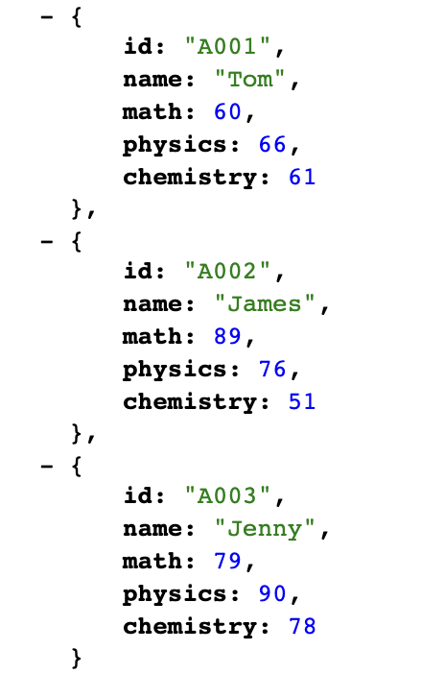
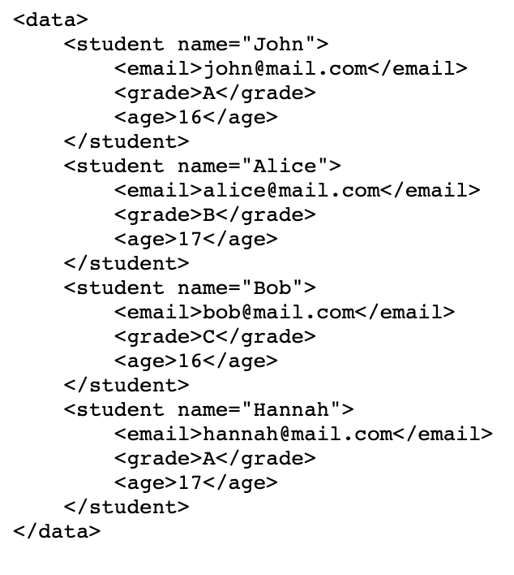
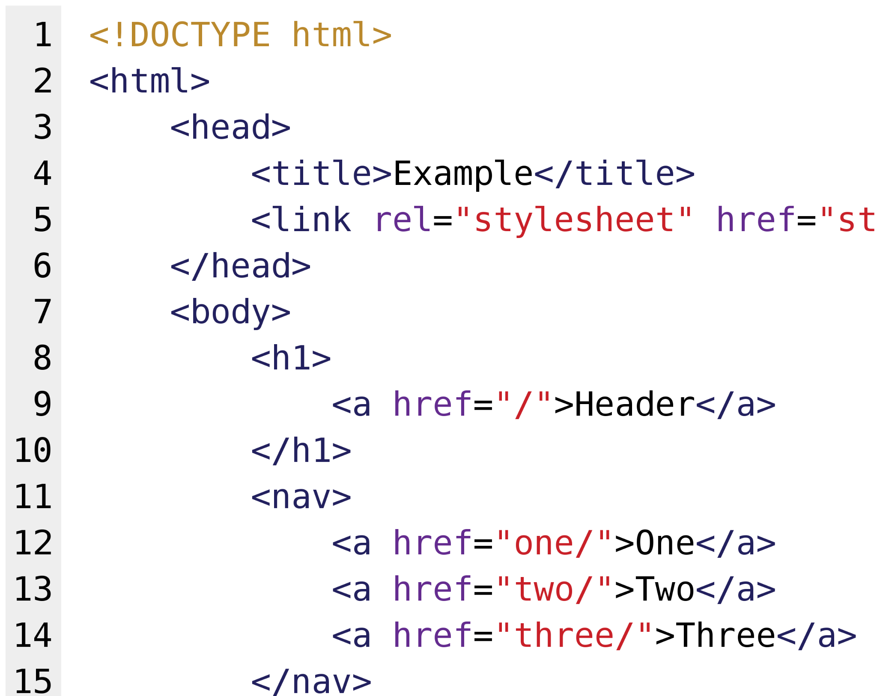
Importing Data
CSV
JSON
XML
HTML
Notes:
joleena

Slide 5
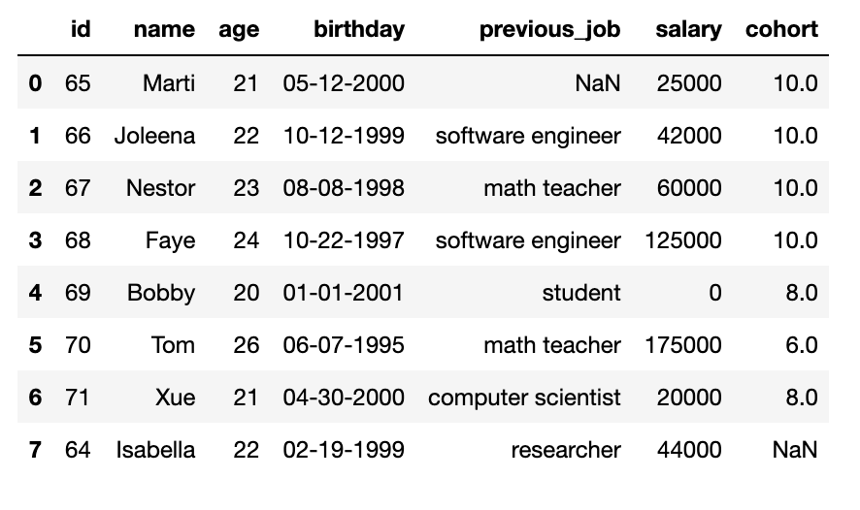
Importing Data
Pandas DataFrame
Why is this important?
No data → No analysis/modeling!
We can combine data from different sources with different file types
Easier to complete next steps of EDA
Notes:
joleena

Slide 6



Exploration
Notes:
Exploration can be thought of as the “getting to know you stage”
If you were getting to know a new person, you might ask them “What’s your name? Where are you from? What do you do?”
In the case of a data frame, we have a different set of questions which we ask

Slide 7
Scenario:
You are given a data file and asked to write a newsletter notifying alumni from the MSDS program of all the great achievements of current students and other alumni. In this newsletter you were also tasked of providing a few metrics.

Slide 8
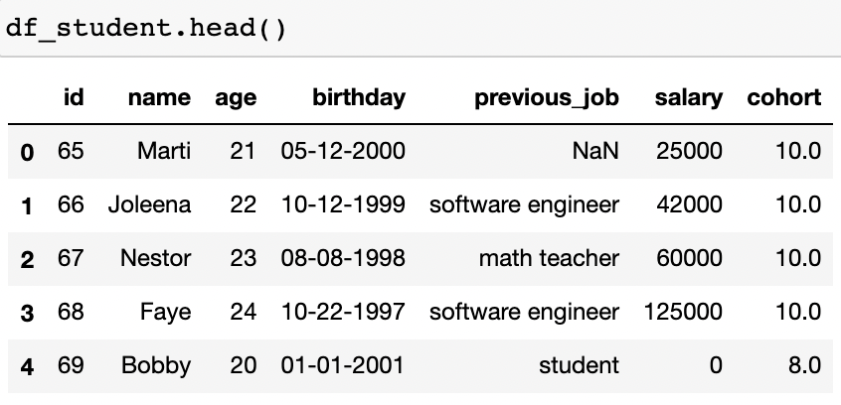
Notes:
Because raw data is so difficult for humans to read, we often read our data file into a data frame, but we don’t really know what is inside. We have to ask it.
Our data frame might have millions of rows, so printing out the entire table is not possible. The head function allows us to see the first n rows, 5 by default, of our data frame, which just gives us a peek into what the data look like.
For our sc

Slide 9
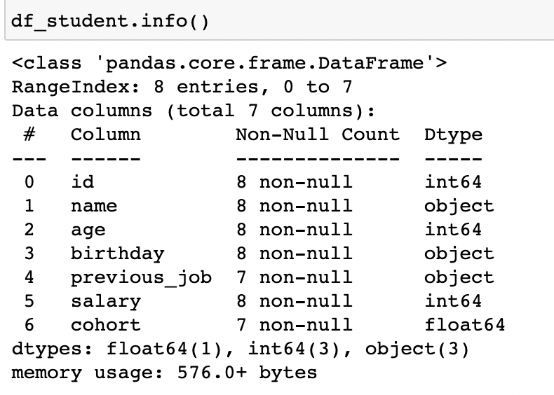
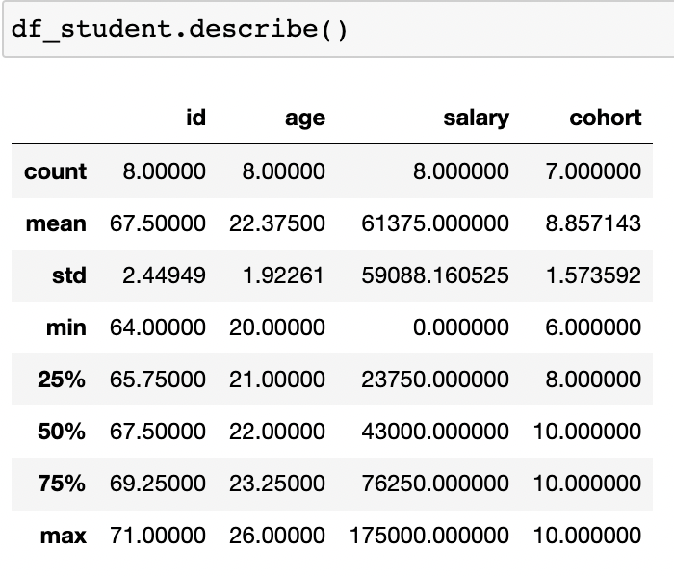
Notes:
Marti
We also want to look at some summary tables that give us an idea of what all our data look like.
The describe table will give some summary statistics for the distribution of numeric variables. In our example, we can determine that our data is likely representing graduate students based on the range of ages included.
The info function gives the shape of the data frame (8 rows, 7 columns), the names of the columns, the data types, and the non-null count. As we can we, we have 7 non-null cohort numbers and 8 non-null id’s. This means one of our entries does not have a value for “cohort”.

Slide 10
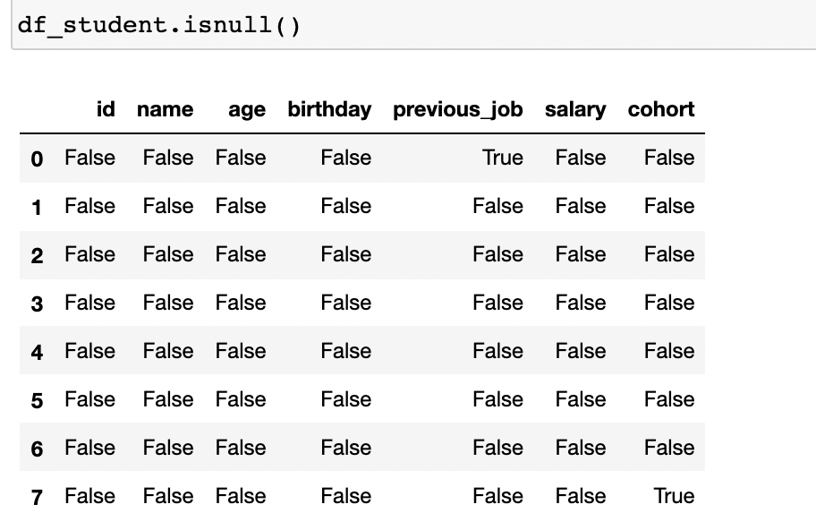
Notes:
Because null values are such a common problem in data science, Pandas has more functions which will help us handle them. The isnull function can be called on any subset of a dataframe, in this example we are using the entire dataframe. It will return a data frame of the same size with boolean true or false values indicating the nullity of the entry.

Slide 11
Preprocessing
Why is this important?
Results may be unreliable if data is misleading or incomplete
What’s the process?
Converting Data Types
Appending & Removing Data
Reindexing Data

Slide 12
Overview of Data Types
Example | Data Type | Type in Pandas
1 | Integer | int64
1.0 | Floating Point | float64
08-09-2021 | Date | datetime[ns]
“hello” | String | object
[1st, 2nd, 3rd] | List | category

Slide 13
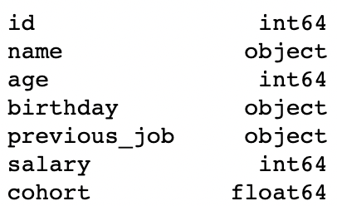
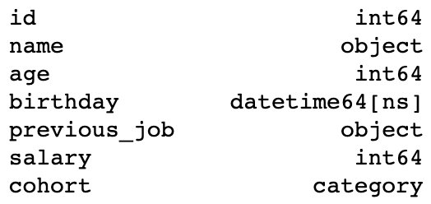
Converting Data Types
DataFrame: df_student
Function Call: dtypes
Before
After

Slide 14
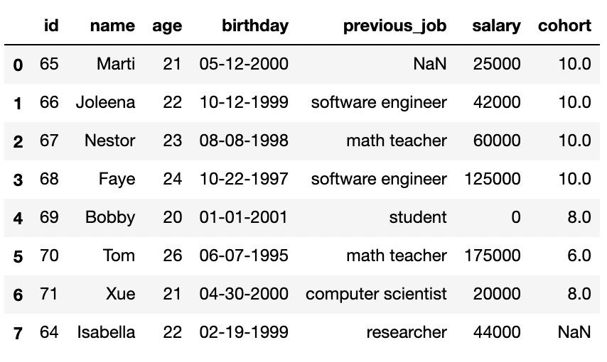
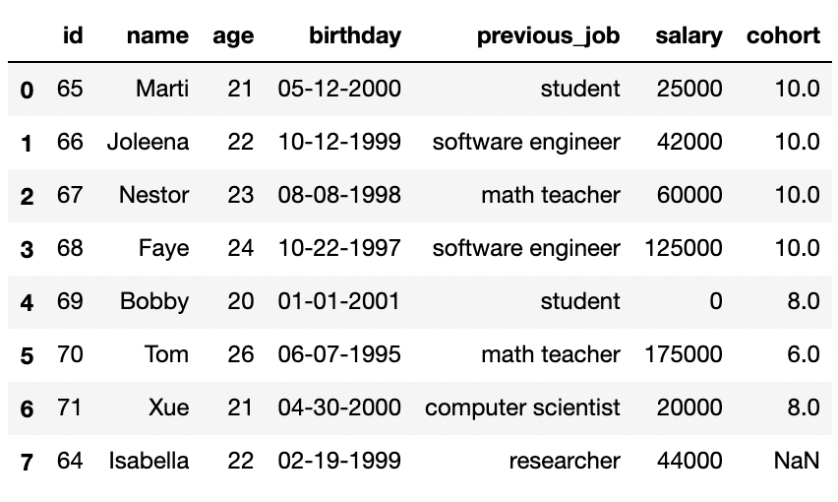
Handling Missing Data
Before
After

Slide 15
What’s Next?
We can now group together all students by their cohort or by their previous job.
We can do a few calculations about how average salary has changed from cohort to cohort
Can we highlight women in Data Science?

Slide 16
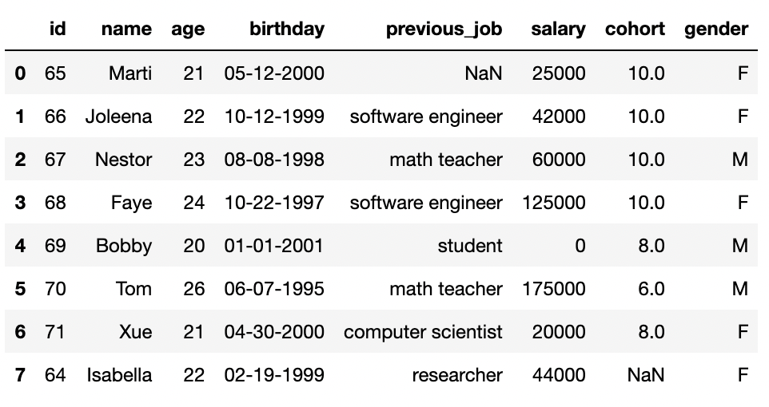
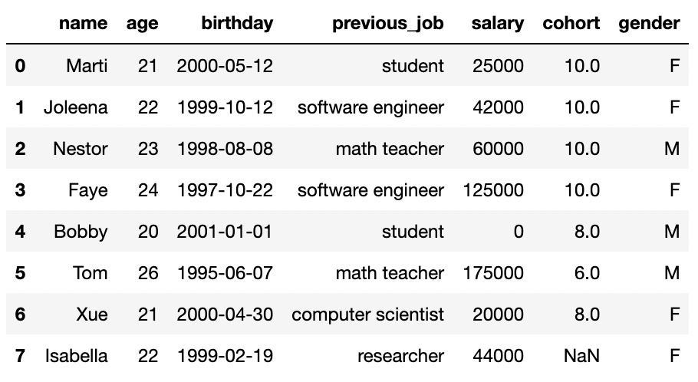
Appending and Removing Data
df_student['gender'] = ['F', 'F', 'M', 'F', 'M', 'M', 'F', 'F']
df_student = df_student.drop('id', axis=1)

Slide 17
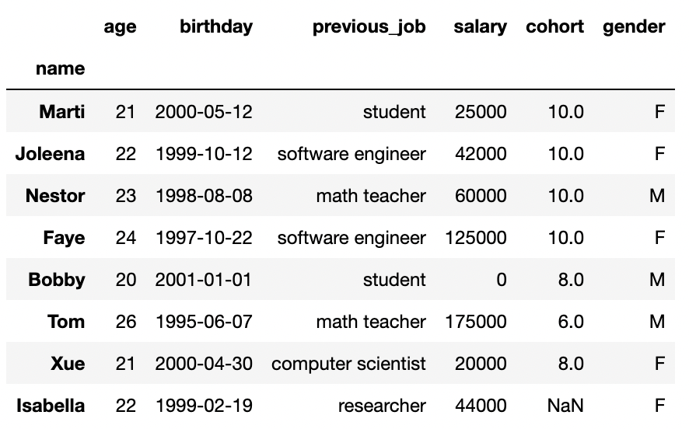
Reindexing Data
We can reference a student by their name
Data is now clean and set up for building insights.

Slide 18
Things To Consider:
Do you have enough data?
What is the purpose or goal of your analysis?
What relationships do you want to investigate further?
Who, what, and/or how much impact does your analysis produce?
Research Questions

Slide 19
Examples of Research Questions
Do women make less than men?
Are recent cohorts making more than previous ones?
What previous job translate to being successful after the MSDS program?

Slide 20
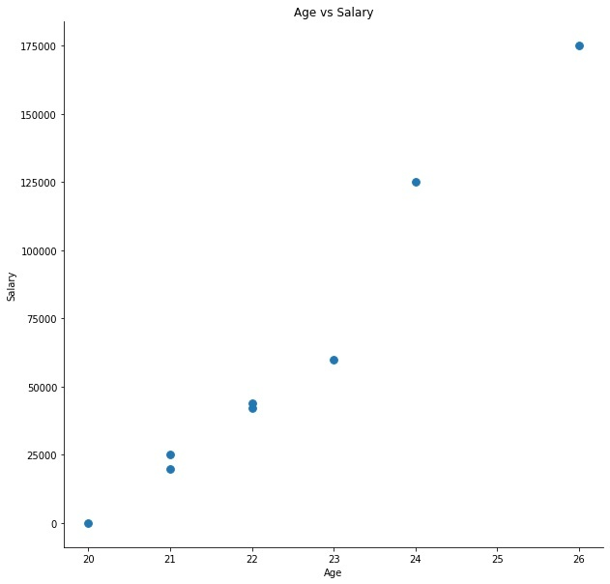
Visualization
-Scatter plot: mainly between 2 features

Slide 21
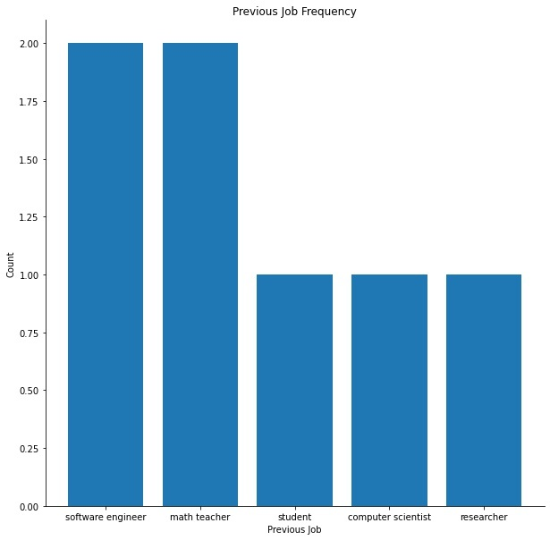
Visualization
-Bar plot: the comparisons between the discrete categories

Slide 22
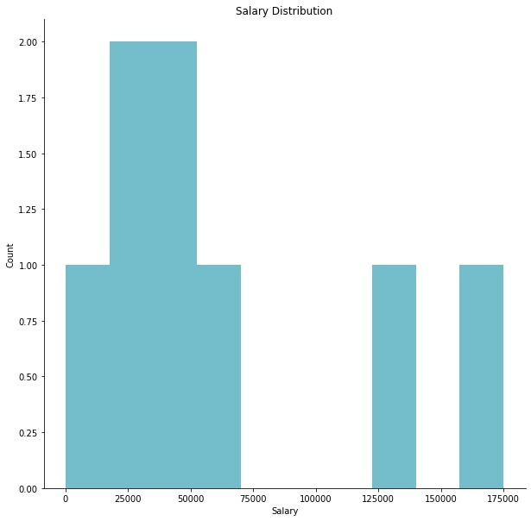
Visualization
-Histogram plot: the graph showing frequency distributions

Slide 23
In Summary
Pandas Library
Useful Tool
Works well with other libraries
Import Data
Various sources and file types
Exploration
Understanding data utilized
Extracting useful information
Preprocess Data
Least favorite but highly important
Pandas provides ease-of-access
Research Question(s)
Important stage in larger scheme
Checks & Balances
Visualization
Two divisions: User & Audience
Clearly report your findings

Slide 24
Thanks!
Any questions?
You can find out more at:
shorturl.at/avDQ9

